Slide 1
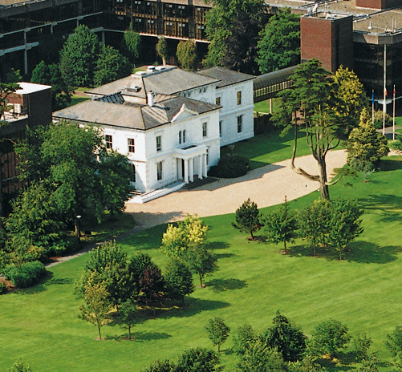


PROJECT MANAGEMENT IN PRACTICE
Project Integration Management
Lecture No: 3 Week: 2
Vispi Shroff
Sub Heading
And Date

Slide 2

Recap
Project Lifecycle
Project Phases
Different Approaches
Project Management Process Groups
Initiating
Planning
Executing
Monitoring & Controlling
Closing

Slide 3
Today’s Topics & Learning Outcomes
Project Integration Management
Project Selection
Strategic Planning
Project Selection Methods
Developing the Project Charter
Developing the Project Management Plan
Project Execution
Process of monitoring and Controlling Project Work
Change Control & Change Management
Closing a Project

Slide 4
What is Project Integration Management?
It involves the co-ordination of all the other PM knowledge areas
It takes place throughout the lifecycle of the project.
Ensures the right project components and knowledge areas are utilised at the right time.
It can be the glue that holds the project together.
It takes place within the context of the entire organization
Not just the integration of the processes, but the integration of people & work efforts through good communications and relationships management.

Slide 5
Key to Overall Project Success - Good Project Integration Management
Project managers must coordinate all of the other knowledge areas throughout a project’s life cycle
Many new project managers have trouble looking at the “big picture” and want to focus on too many details (see opening case for a real example)
Project integration management is not the same thing as software integration

Slide 6
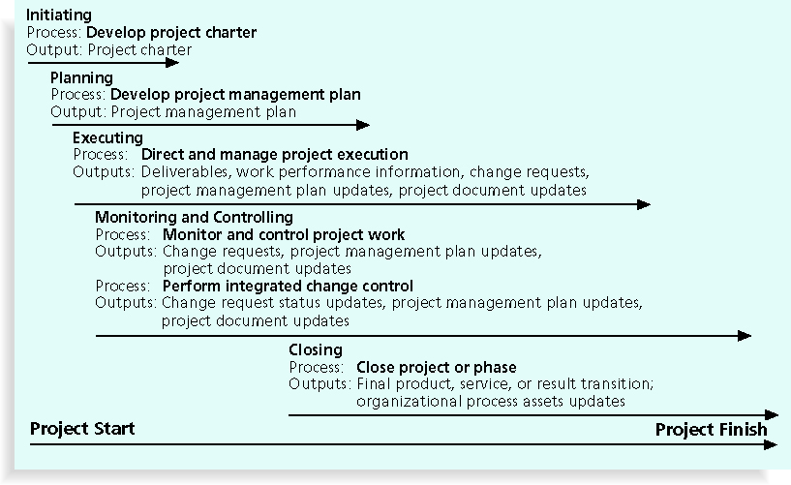
Overview of Project Integration Management

Slide 7
Before the Project Charter…
Potential projects must be identified.
A project must be selected.
Requires Strategic planning
On what basis would you select a project?
Stakeholders must be identified.
Other necessary data must be gathered.

Slide 8
Strategic Planning
Strategic planning is carried out by companies to achieve a sustainable competitive advantage, something that will differentiate them from their competitors over a sustainable period of time.
- It involves determining long-term objectives, predicting future trends, and projecting the need for new products and services
Organizations often perform a SWOT analysis
As part of strategic planning, organizations:
Identify potential projects
Use realistic methods to select which projects to work on
Formalize project initiation by issuing a project charter

Slide 9
Selection of Projects – Different Methods
Not enough resources or time available for all the projects which could potentially be done.
Methods of selection of projects could include
Focussing on organisational needs
Categorising projects
Performing financial analyses (NPV, ROI, Payback Analyses, etc)
Weighted Scoring Model
Using a Balance Scorecard (go to www.balancescorecard.org)

Slide 10
Broad Organizational Needs or Categorisation
Organisational Needs
Difficult to justify financially, but everyone agrees it needs to be done.
There is a need for it, there are funds available, a strong desire to make it succeed.
Categorisation
Does it address a problem, opportunity or a directive.
Overall priority
How long will it take and when it is needed.

Slide 11
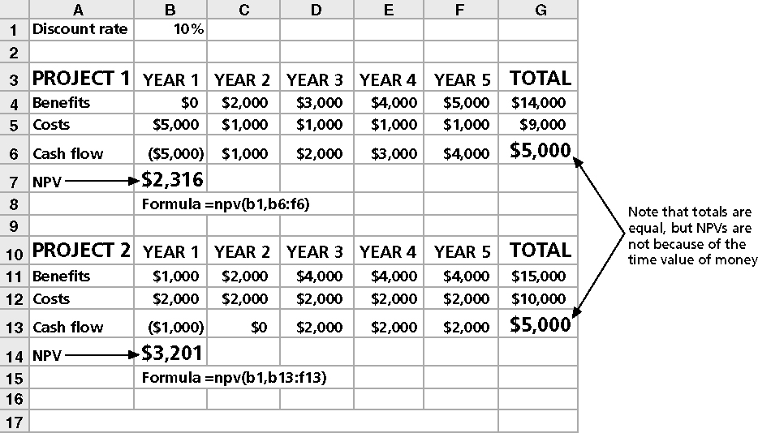
Financial Analyses
- Net Present Value (NPV) analysis

Slide 12
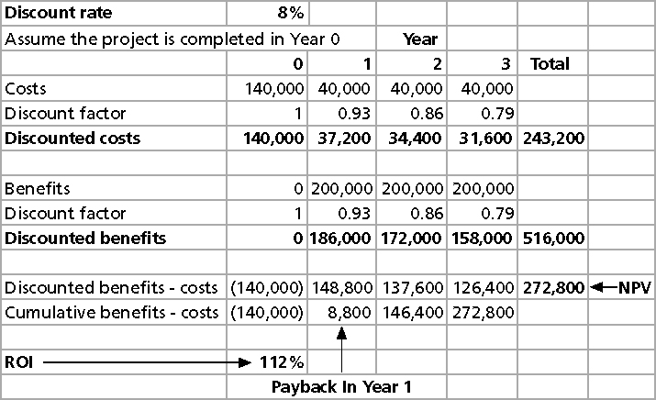
Financial Analyses

Slide 13
Weighted Scoring Model

Slide 14
Activity – Weighted Scorecard

Slide 15
Project Charter Document
- After deciding what project to work on, it is important to let the rest of the organization know
- A project charter is a document that formally recognizes the existence of a project and provides direction on the project’s objectives and management
- Key project stakeholders should sign a project charter to acknowledge agreement on the need and intent of the project; a signed charter is a key output of project integration management

Slide 16
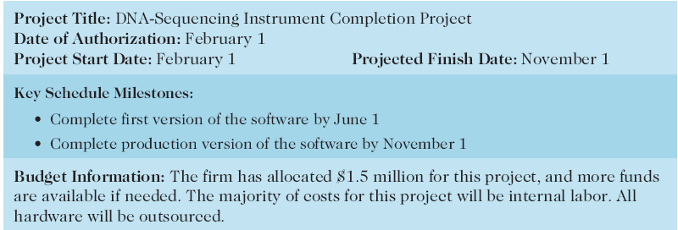
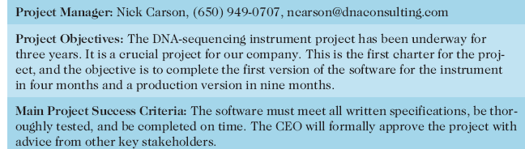
Project Charter Example

Slide 17
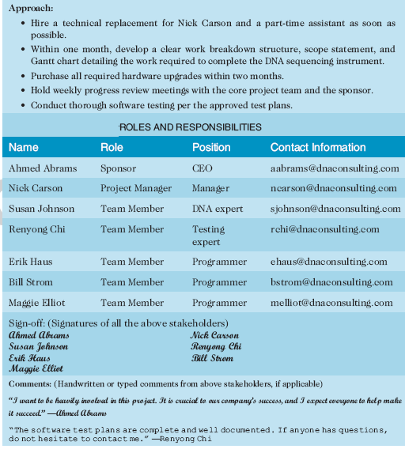
Project Charter Example - Continued

Slide 18
Project Management Plan
Remember… this is part of Project Integration.
- A Project Management Plan presents a complete overview of all aspects of the project.
Inputs into the plan include
The Project Charter
Plans from the other Knowledge Areas
Environmental Factors
Organisational Processes & Assets

Slide 19
Common Elements of a Plan
Introduction or overview of the project
Name, description, needs it addresses/problems solved, sponsor’s name, project manager & key team members, deliverables of the project, reference materials, etc.
Description of how the project is organized
Organisational Charts, Responsibility outlines, other process related information.
Management and technical processes
Mgmt objectives - what, why, assumptions, etc
Project controls
Risk Management Approaches
Staffing, technical process/tools used, etc
- Work to be done, schedule, and budget information

Slide 20
Common Elements of a Plan
Work to be done, Schedule & Budget Information
Scope Management Plan
Major Work Packages
Key Deliverables, Quality
Other Work Related Information – Assumption
Project Schedule
Summary Schedule
Detailed Schedule
Other info
Budget
Summary Budget
Detailed Budget
Other info

Slide 21
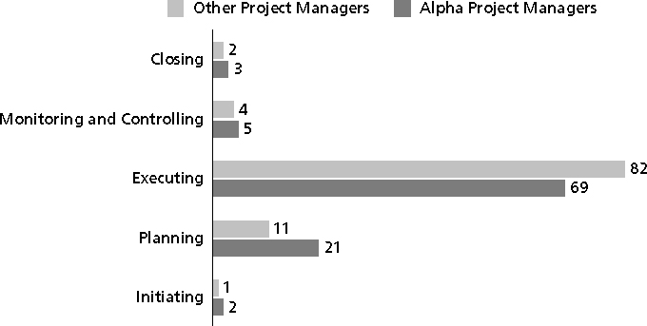
Project Execution
- Project execution involves managing and performing the work described in the project management plan
The majority of time and money is usually spent on execution.
Remember..
- The application area of the project directly affects project execution because the products of the project are produced during execution

Slide 22
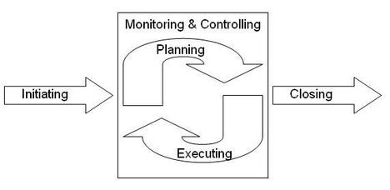
Coordinating Planning & Execution
- Intertwined and inter-related
Importance and reliance on the other process.
Where does the Project Manager fit in?

Slide 23
Providing Leadership & Supportive Culture
- Lead by example
Lead from behind
Supportive culture through well-defined organisational processes
Use of templates
Organisational Politics
The PM should have
Product knowledge
Business knowledge
Domain Area knowledge

Slide 24
Project Management Tools & Techniques
Methodologies
PRINCE 2, Scrum, etc
Expert Judgement
One cannot be the master of all trades, so rely on the experts when needed.
Project Management Information Systems
- Utilise the products which are out there

Slide 25
Monitoring & Controlling
‘Change is the only constant’.
In Software & IT Projects, changes are extremely likely.
Imperative to have a plan to monitor the project progress. This requires tools for measurement of progress,
Project progress must be communicated frequently and wherever needed.
Measurement is carried out against a project baseline. A baseline is the Project Management Plan + approved changes.

Slide 26
Integrated Change Control
Three main objectives are:
- Influencing the factors that create changes to ensure that changes are beneficial
- Determining that a change has occurred
- Managing actual changes as they occur

Slide 27
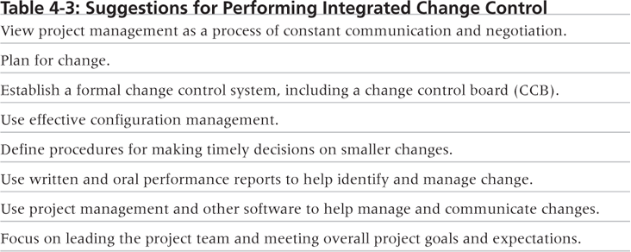
Suggestions for performing ICC

Slide 28
Change Control System
A formal, documented process that describes when and how official project documents and work may be changed.
Describes who is authorised to make the changes (change control board)
Describes how to make the changes

Slide 29
Change Control Board (CCB)
A formal group of people responsible for approving or rejecting changes on a project.
Provide guidelines for preparing change requests, evaluating change requests and manage the implementation of approved changes.
Where should the people come from?
Timely Changes
- Delegate changes to the lowest level possible, but keep everyone informed of changes.

Slide 30
Configuration Management
- Ensures that the descriptions of the project’s products are correct and complete
- Involves identifying and controlling the functional and physical design characteristics of products and their support documentation
Configuration management specialists identify and document configuration requirements, control changes, record and report changes, and audit the products to verify conformance to requirements
Visit www.icmhq.com

Slide 31
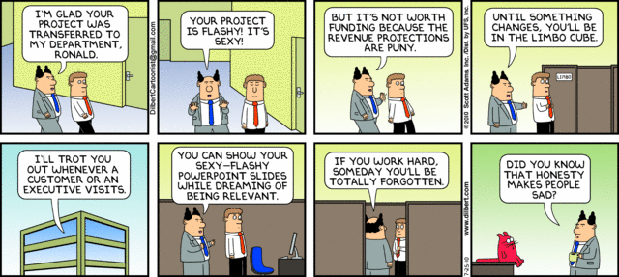
Any Thoughts, Questions, Ideas?
- July 25th, 2010

Slide 32
Reading Materials for the Week
PMBOK Guide – Project Scope Management,
Schwalbe, K. – Information Technology Project Management, Chapter 5

Slide 33
Conclusions
Project Integration Management involves… coordinating all other knowledge areas throughout the project’s lifecycle.
Main Process include…
Develop project charter
Develop project management plan
Direct and manage project execution
Monitor and control project work
Perform integrated change control
Close the project or phase.
Project Management, and Project Integration is
Not just about the project, but also…
Not just about technology, but also…
Project Integration is key to the success of a project.
Project Integration is the ‘glue that binds the project together.’

Slide 34
References
- PMBOK Guide, 4th Edition
Schwalbe, K. – Information Technology Project Management – Chapter 4
Dilbert Comics.

